Slide 1

WIPRO NGA Program – Java Selenium Batch 4
Capstone Project Presentation –13th and 14th March
Project Title Here - DemoWebShop_Automation
Presented by – Jeeva Pradeesh P
www.rpsconsulting.in

Slide 2

Table of contents
Project Overview
Tools and Technology
Project Design
BDD Cucumber with Page Object Mode
GitHub
Jenkins
Conclusion
2025 - RPS Consulting all rights reserved

Slide 3
ProjectOverview
This project automates testing of the Demo Web Shop website to ensure smooth functionality and user experience.
It uses Selenium WebDriver and Cucumber BDD with the Page Object Model (POM) for maintainability. The framework supports Chrome, Firefox, and Edge for cross-browser testing and uses Apache POI for Excel-based data-driven testing.
Maven manages dependencies, and TestNG/JUnit handles test execution. Integration with Jenkins/GitLab CI enables continuous testing, with ExtentReports/Allure generating detailed reports and screenshots on failure.
The framework follows best practices such as centralized error handling, reusable utilities, dynamic locators, and detailed logging, covering key e-commerce flows: registration, login, search, cart, and checkout.
2025 - RPS Consulting all rights reserved

Slide 4
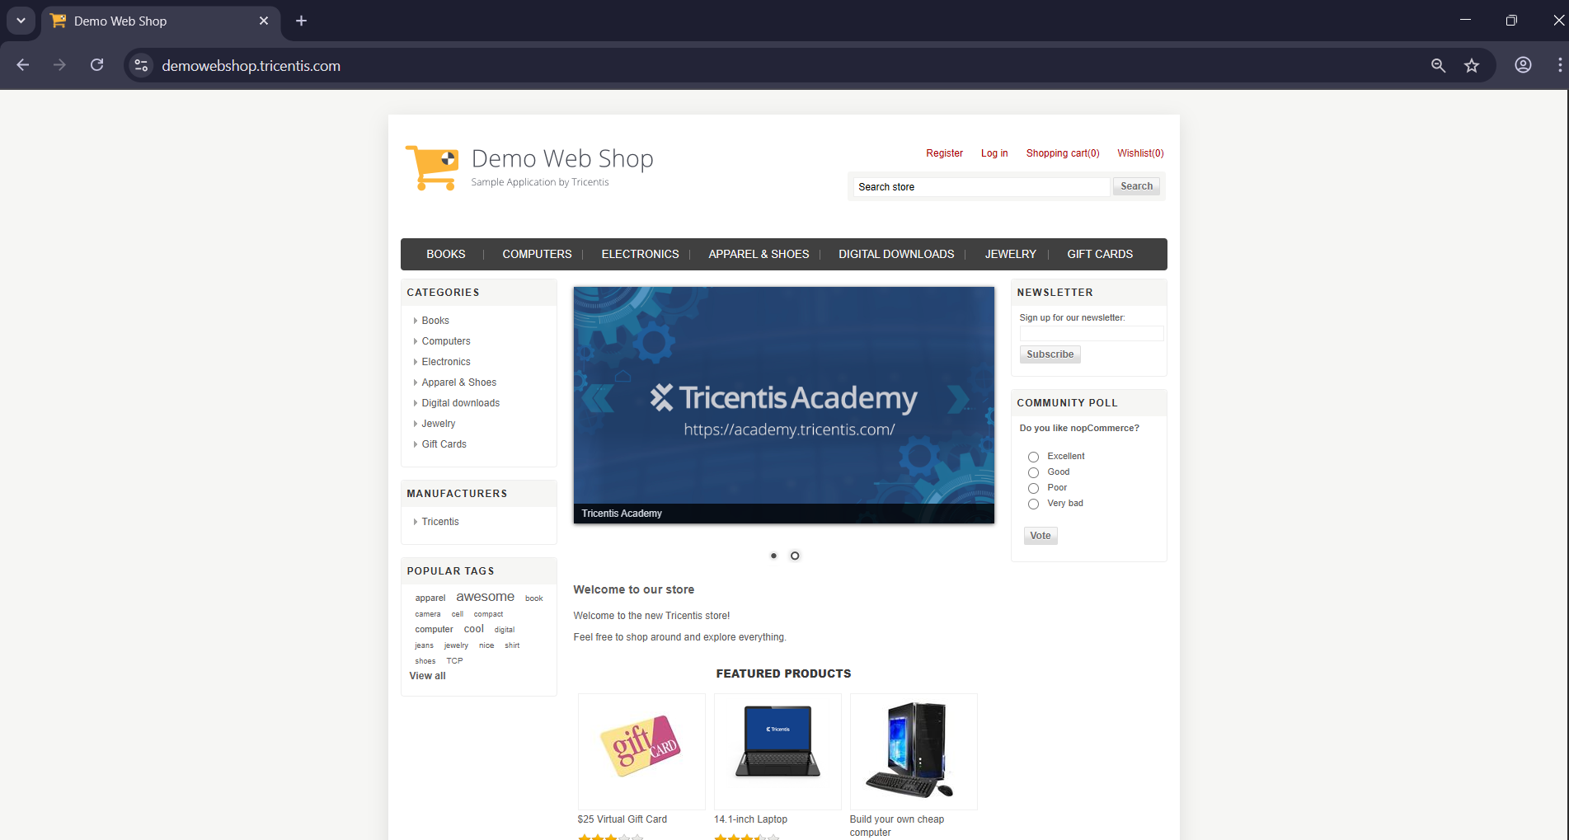
Application Website
2025 - RPS Consulting all rights reserved

Slide 5
Tools and Technologies
Eclipse IDE
Maven
Selenium WebDriver
TestNG
BDD Cucumber
Page Object Model
Allure Report
GitHub
Jenkins
2025 - RPS Consulting all rights reserved

Slide 6
Project Design
Behavior-Driven Development approach (BDD)
Page Object Model (POM)
Data-Driven approach
GitHub
Jenkin
2025 - RPS Consulting all rights reserved

Slide 7
BDD Cucumber with Page Object Mode
BDD – Behavior-Driven Development
BDD is a software development approach that encourages collaboration between developers, testers and business stakeholders using plain language to define behavior.
It focuses on writing test scenarios in a natural, readable format making requirements easy to understand
Cucumber
Cucumber is a BDD testing tool hat allows writing test cases in Ghenkin syntax which uses natural language to describe application behavior
2025 - RPS Consulting all rights reserved

Slide 8
BDD Cucumber with Page Object Mode
Page Object Model – POM
POM is a design pattern in selenium automation that separates page-specific logic and UI locators into reusable page classes
It improves code maintainability and readability by encapsulating interaction logic and reducing duplication across tests
2025 - RPS Consulting all rights reserved

Slide 9
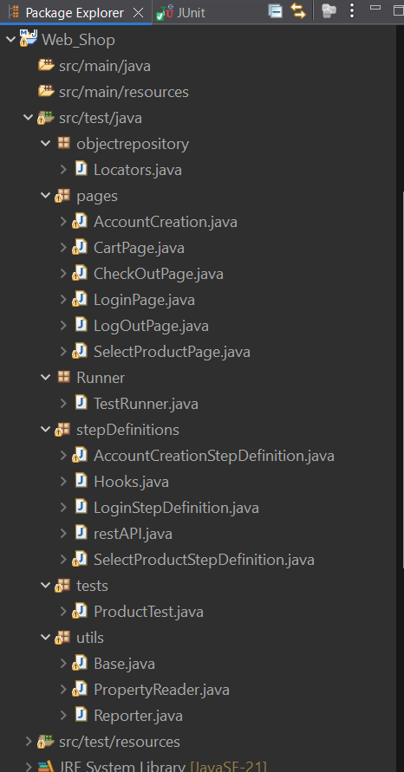
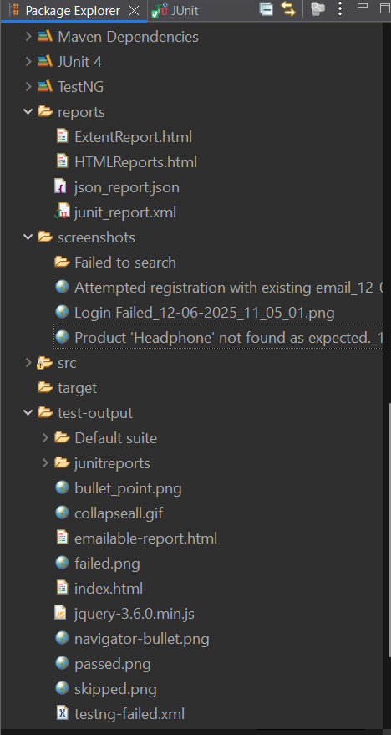
Project Structure

Slide 10
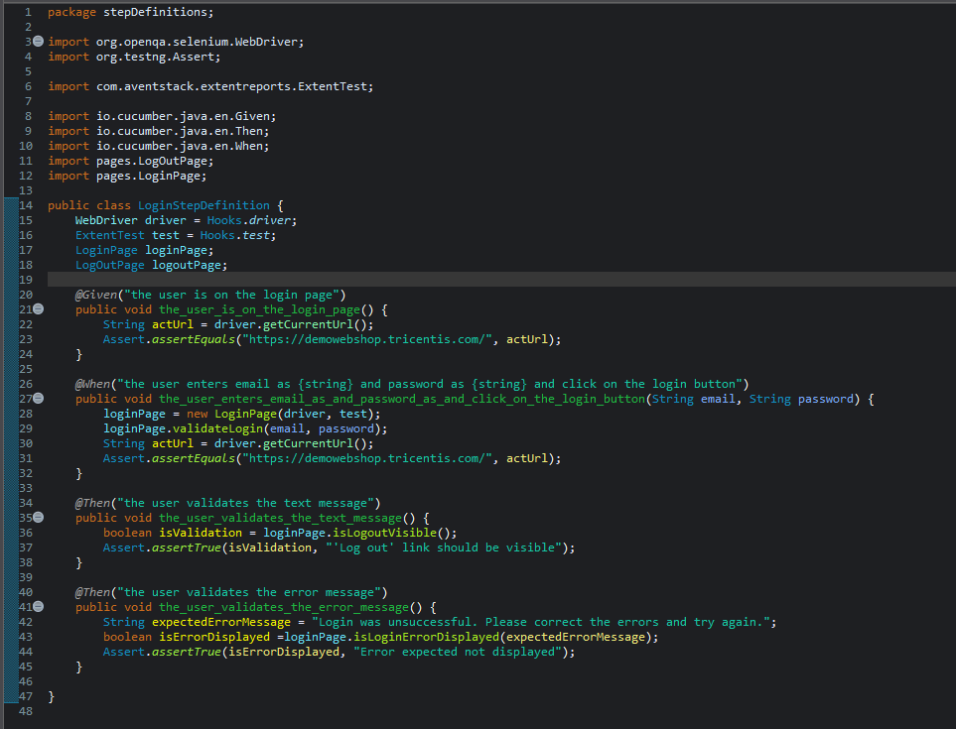
Screenshot of Login Step Definition File
2025 - RPS Consulting all rights reserved

Slide 11
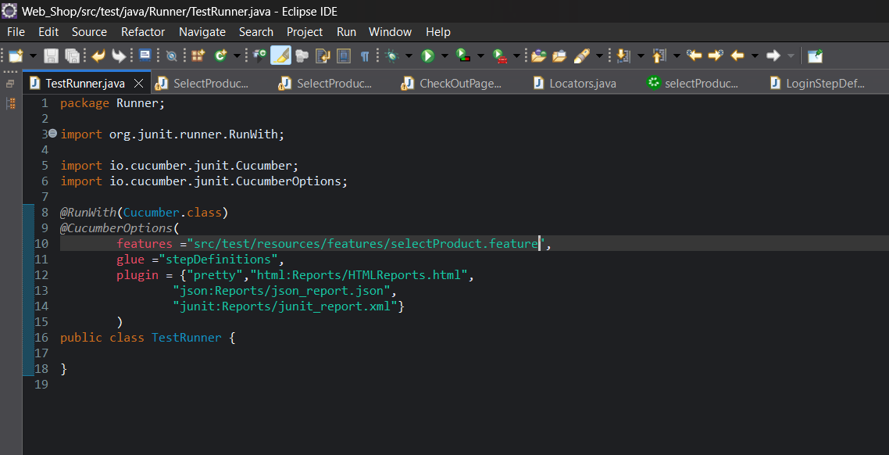
Screenshot of Test Runner File
2025 - RPS Consulting all rights reserved

Slide 12
Screenshot of Test Runner File
2025 - RPS Consulting all rights reserved

Slide 13
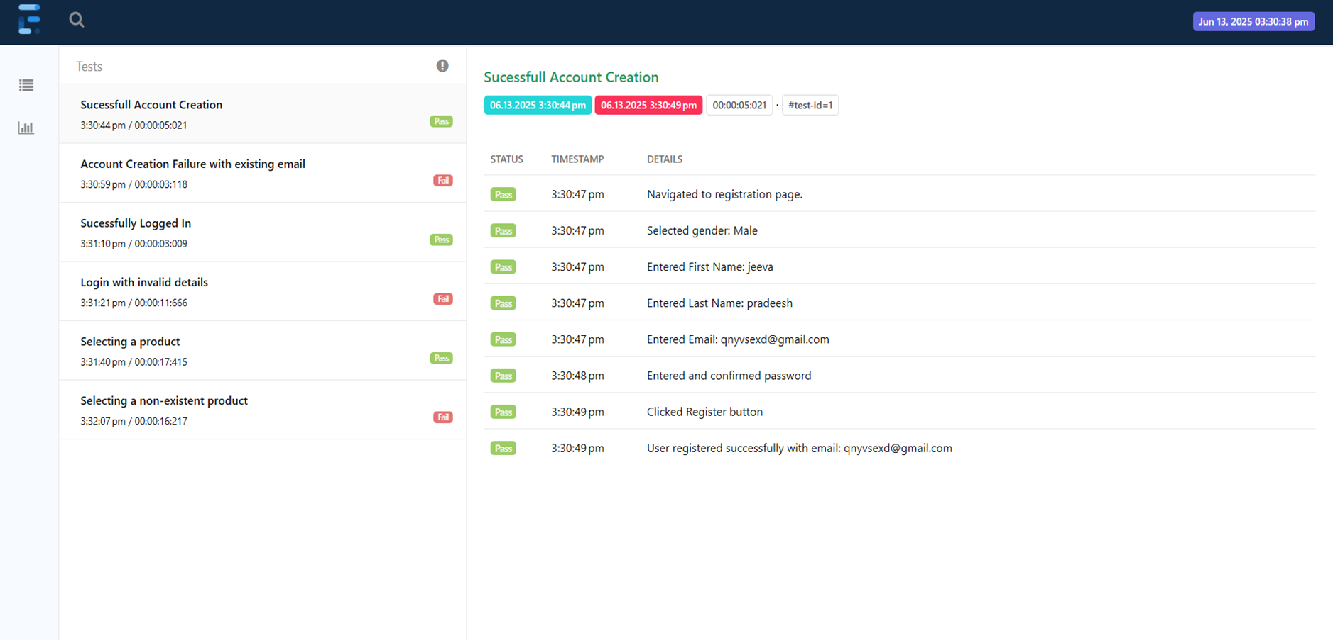
Extent Report
2025 - RPS Consulting all rights reserved

Slide 14
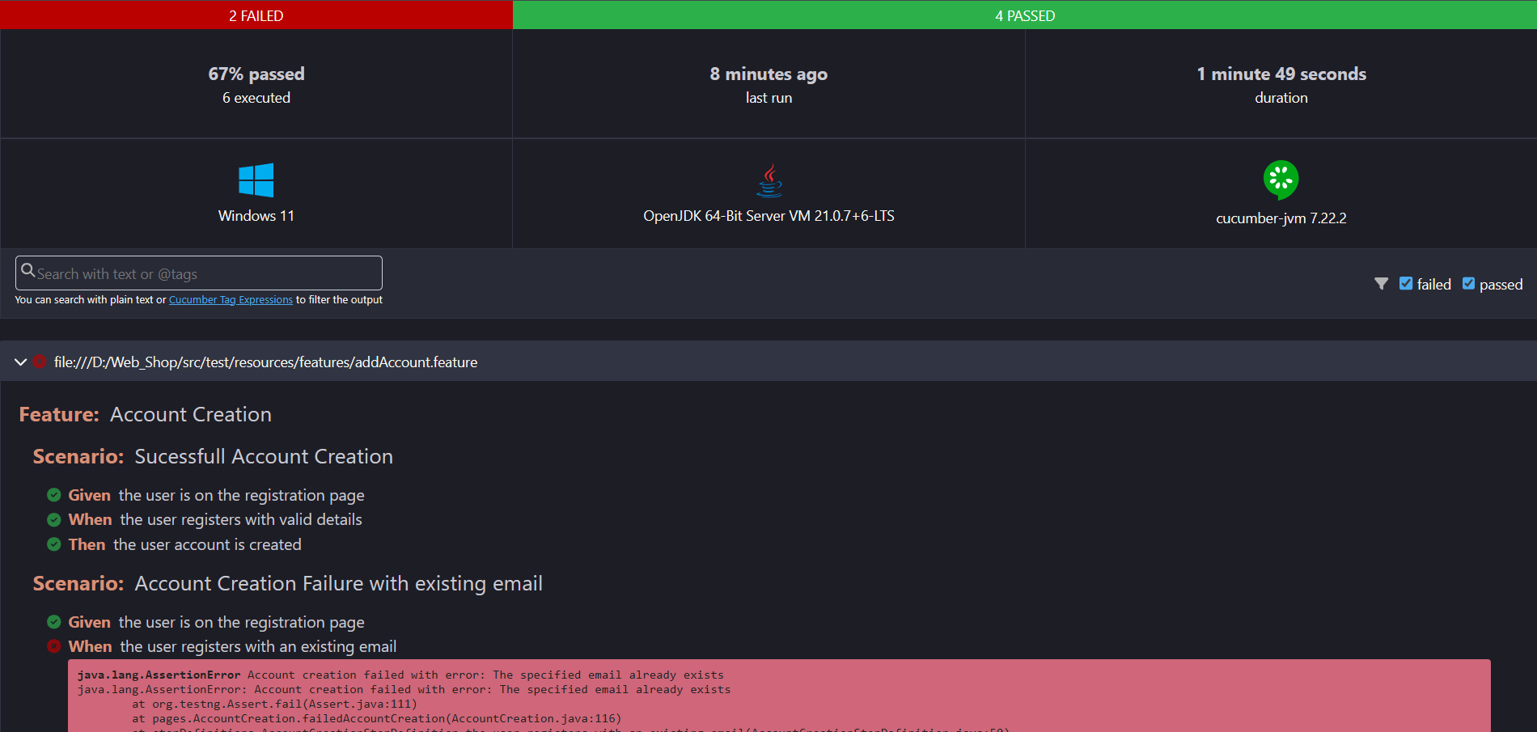
Cucumber Report
2025 - RPS Consulting all rights reserved

Slide 15
Screenshot of Test Runner File
2025 - RPS Consulting all rights reserved

Slide 16
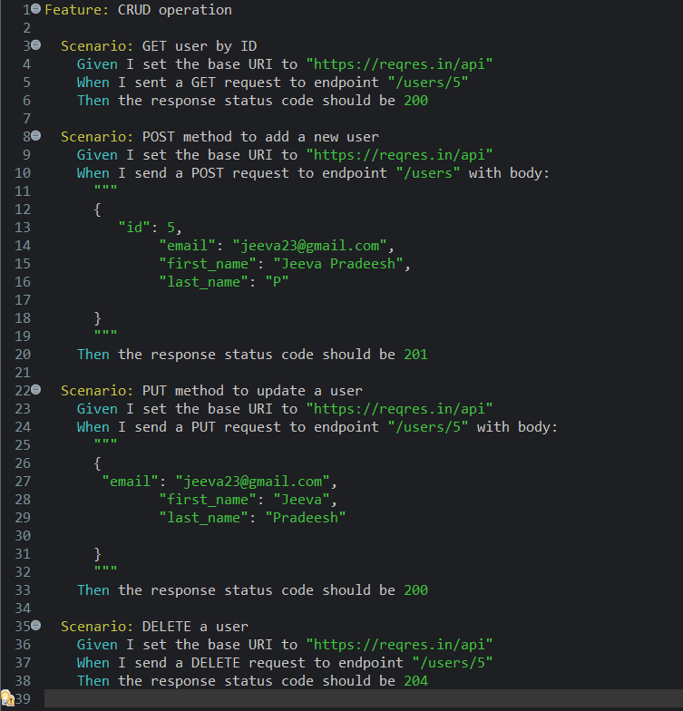
Screenshot of API Feature File
2025 - RPS Consulting all rights reserved

Slide 17
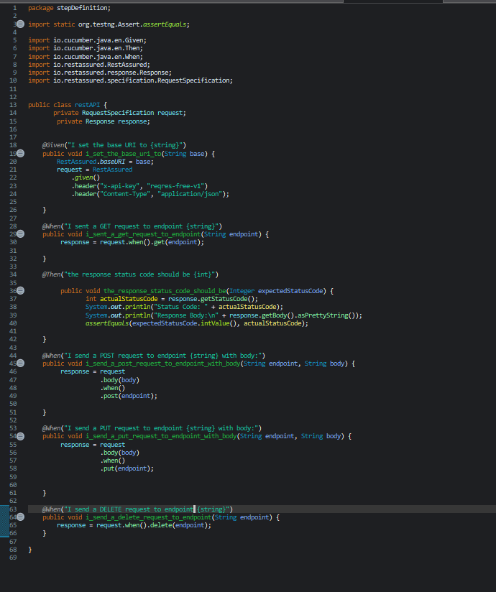
Screenshot of API Step Definition File
2025 - RPS Consulting all rights reserved

Slide 18
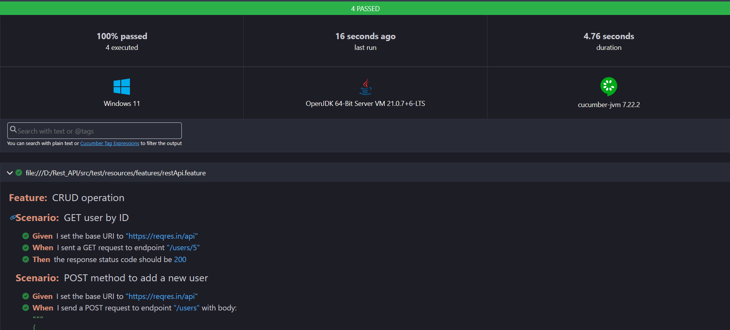
Cucumber Report
2025 - RPS Consulting all rights reserved

Slide 19
GitHub Screenshot

Slide 20
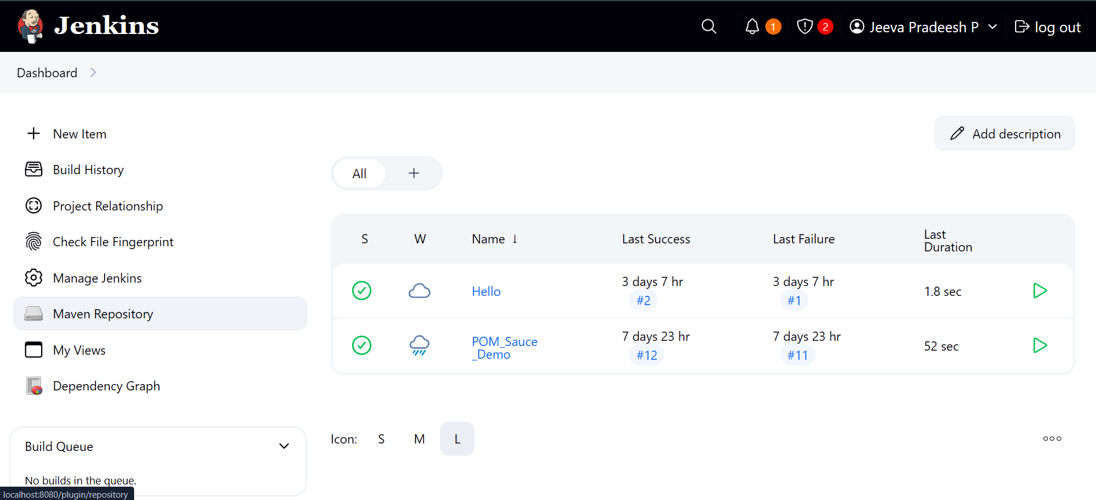
Jenkins Screenshot
2025 - RPS Consulting all rights reserved

Slide 21
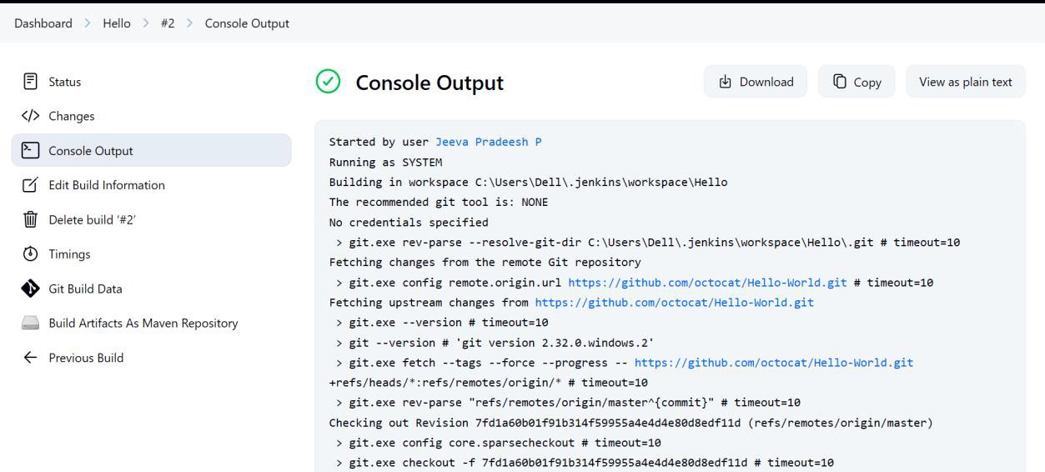
Jenkins Results Screenshot
2025 - RPS Consulting all rights reserved

Slide 22
Conclusion
Demo Web Shop UI Automation : By combining Cucumber BDD with TestNG, we achieved structured and maintainable browser-based test automation. TestNG allowed us to run tests in parallel, manage dependencies, and generate detailed reports — all of which improved efficiency, scalability, and cross-browser testing reliability.
Reqres API Testing : The integration of TestNG with Cucumber for API testing enabled clear, readable test definitions with strong backend validation. TestNG's data-driven capabilities and robust execution control made the API tests more reusable, maintainable, and ready for seamless CI/CD integration.
2025 - RPS Consulting all rights reserved

